Slide 1
Healthcare Claim Submission
Presented by- Angsuman Patra

Slide 2
User Interface(Angular)
MicroService (Dot Net Core API)
Database(SQL server)
Azure implementation

Slide 3
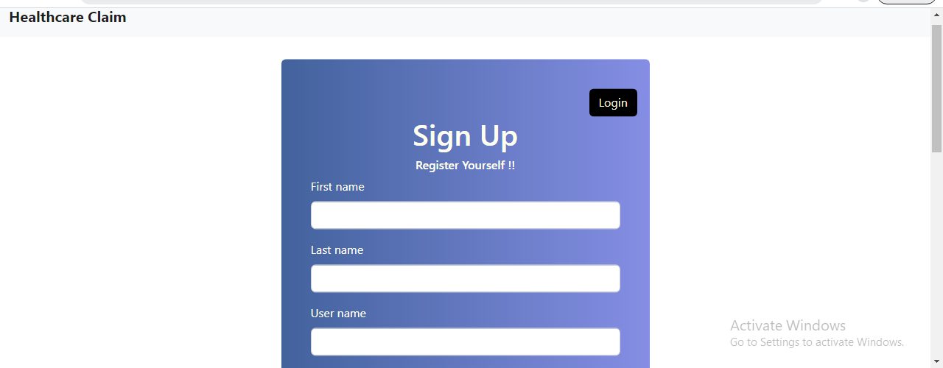
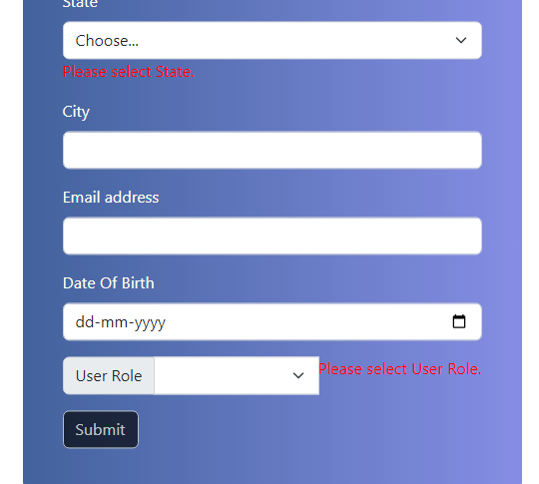
User Registration

Slide 4
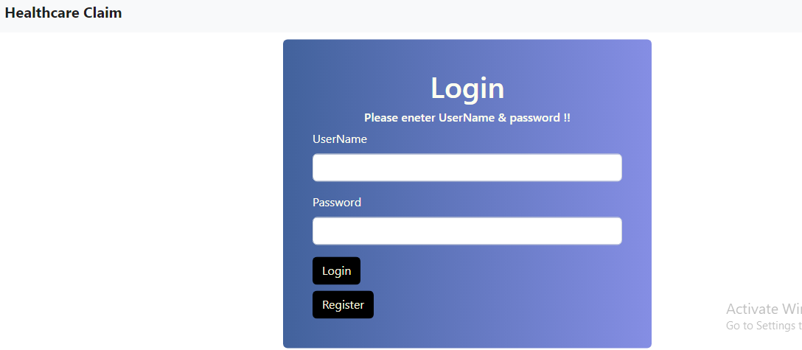
User Login

Slide 5
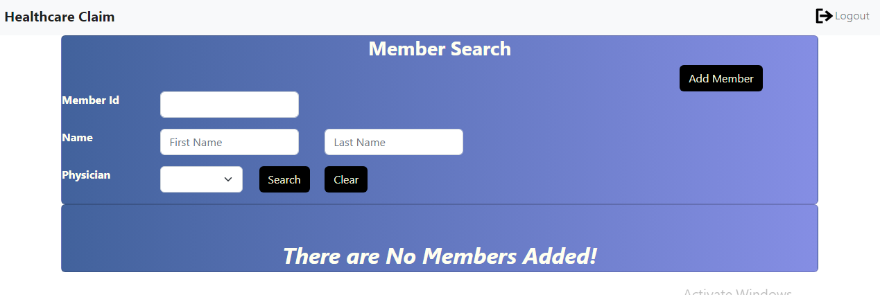
Admin Screen

Slide 6
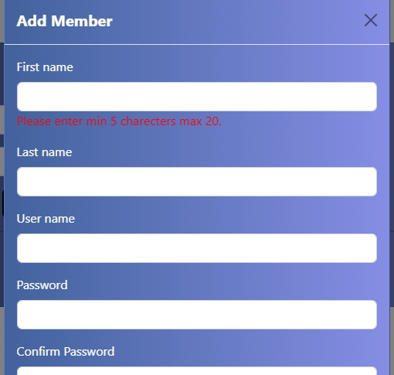
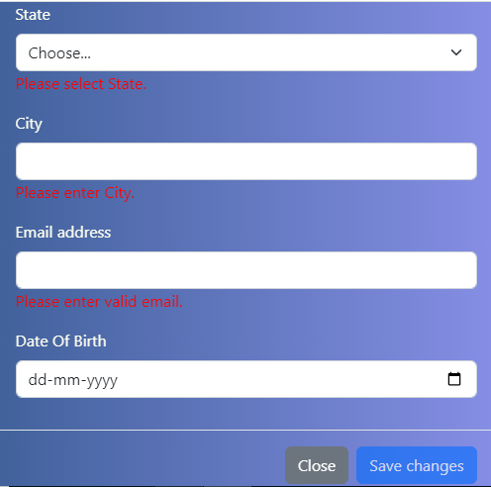
Add Member

Slide 7
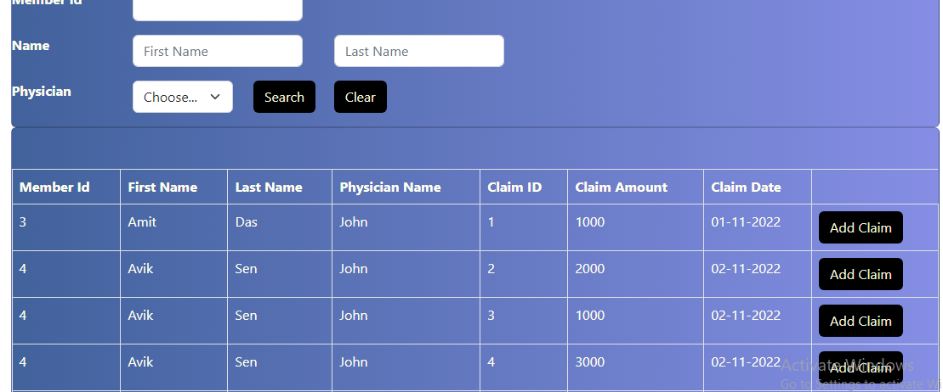
List Of Members

Slide 8
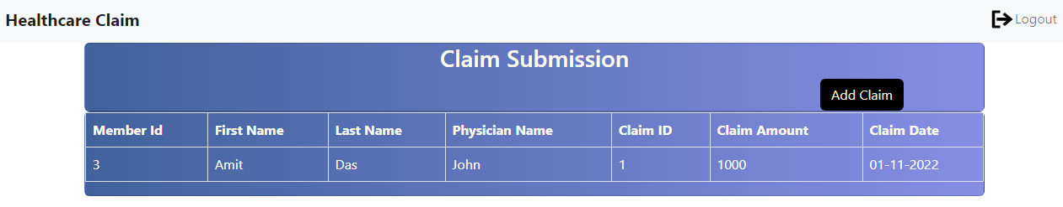
Member screen

Slide 9
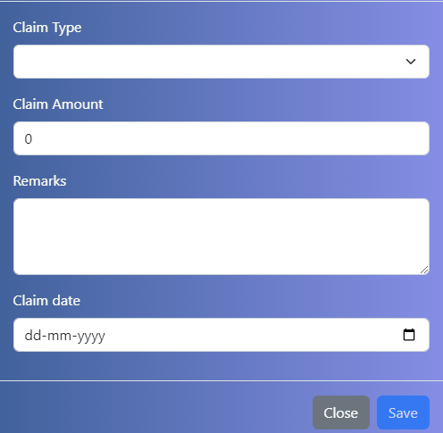
Claim Submission screen

Slide 10
Architecture
Micro services
User interface
Database
Member
service
Angular
Azure SQL
Gateway
Ocelot
Claim
service

Slide 11
Angular Implementation
Form validation
Lazy Loading
Dependency Injection

Slide 12
Web API Structure
Discovery service Consul
Consul
Member
Service
Register Service
Http Client
Retrieve Service Registered
Gateway
Claim
Service
Send - receive Request
Ocelot

Slide 13
Testing Web API
Swagger
Postman

